Slide 1
2019 Caravel Academy Band & Chorus
Music in the Parks
7th / 8th grade trip
Friday May 3rd
Six Flags Great Adventure
5th / 6th grade trip
Saturday May 11th
Hershey Park

Slide 2
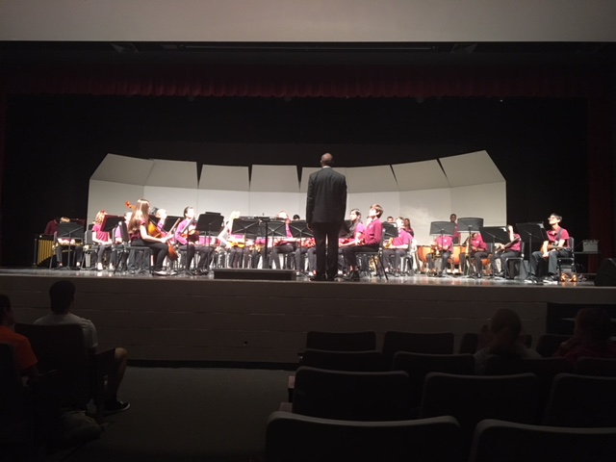
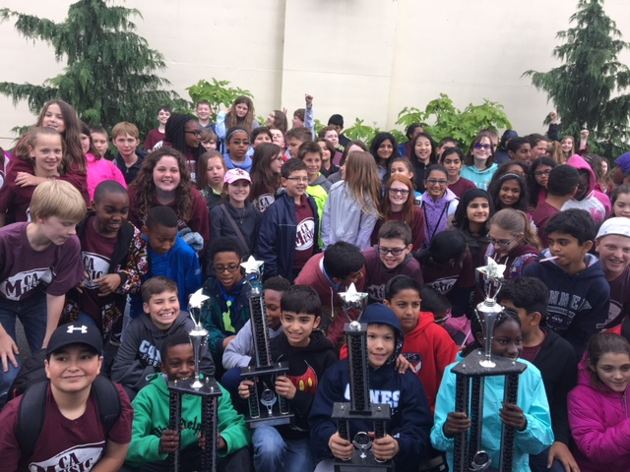
What is Music in the Parks
Music In The Parks festival provides a year-end assessment by an outside panel and reinforces music skills that have been presented by our amazing teachers
Provides a great opportunity for students to perform in locals schools or churches, competing against other schools
A day with lots of fun time in a park followed awards ceremony in the park

Slide 3
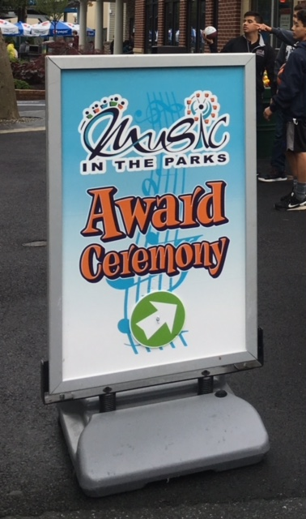
Competition Details
Competition Status and Awards
RATING ONLY: Each organization for Rating Only will receive a trophy with the appropriate rating of superior, excellent, good, fair, or poor.
COMPETITION: Each organization for Competition will receive a trophy with the appropriate rating of superior, excellent, good, fair, or poor and, in addition, will be ranked within their classification.
Superior 90+
Excellent 80+
Good 70+
Fair 60+
Poor 50 or below
There are times we are the only school in our division….so the overall rating is what we aim for

Slide 4
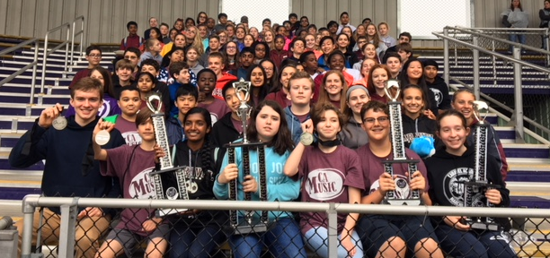
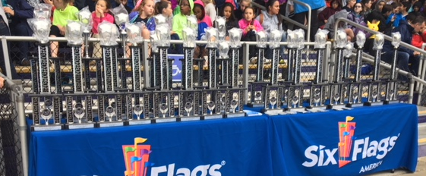
Competition Details
Classification:
Class A – accredited school enrollment less than 750 students
Class AA – accredited school enrollment 750 or higher
Class AAA – school age community ensembles and non-accredited schools only

Slide 5
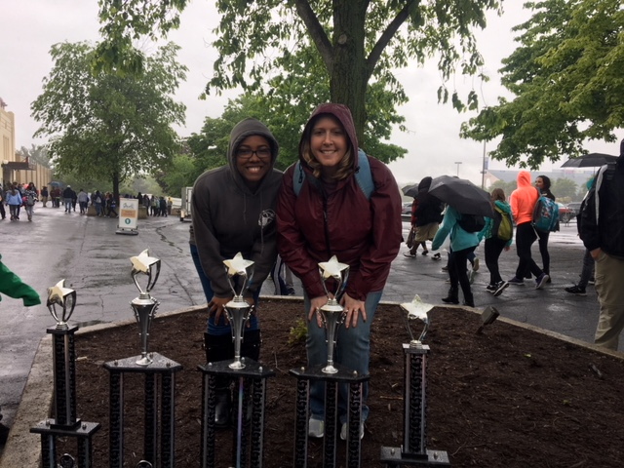
Judging
Band is judged on:
TONE QUALITY: Resonance, Control, Clarity, Focus, Consistency, Refinement, and Likeness of Qualities
INTONATION: Chords, Melodic Line, Ensemble, and Individual
RHYTHM: Accuracy of Note and Rest Values, Duration, Steadiness, Accuracy of Meter, and Precision
TECHNIQUE: Note Accuracy, Attacks, Releases, Articulation, and Legato Style
MUSICALITY: Interpretation Style, Phrasing, Tempi, Dynamics, Balance, Blend, and Expression.
Chorus is judged on:
DICTION: Articulation, clear & concise words
TONE: Overall sound, variety of tone qualities, appropriate for style of piece & age group
BLANE & BALANCE: single voices standing out, sections blend together
MUSICALITY: Sing with line, dynamic contrast, phrasing; does the music come alive
PRESENTATION: present a polished performance, enter & exit stage gracefully

Slide 6
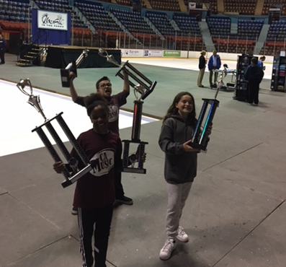
Esprit de Corps
This award is the one they all want!!
This award exemplifies the best qualities of what the Music in the Parks is all about. This is a special award that is not based on the scores from the competition. The Music in the Parks staff evaluates groups throughout the complete event (from the moment we step off the bus to the way our kids behave in the park to the way our kids behave at the Awards Ceremony) to select the one group that most exhibits pride, spirit, enthusiasm, friendliness, exemplary behavior and teamwork for the competition.
As Caravel parents and teachers it is our job to promote these qualities in our students. Winning first place with a Superior rating is always a great achievement however; demonstrating outstanding citizenship is the ultimate award!

Slide 7
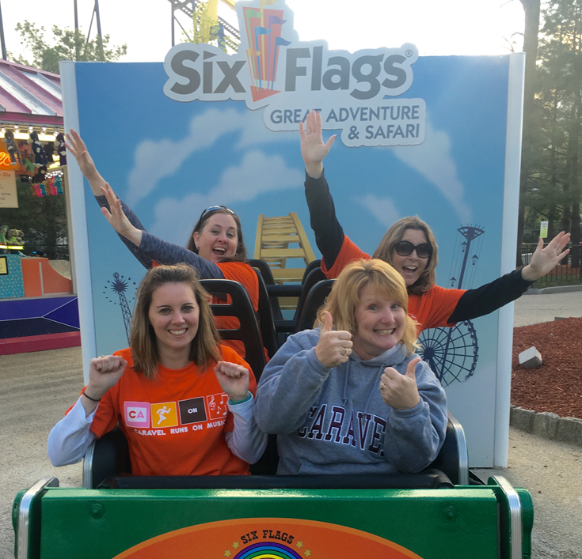
What to Bring
All Students MUST wear their maroon school polo, black pants/skirts (no black shorts or capris), black shoes (no flip flops), black socks and belt to school the morning of the trip.
Students will need their BAND INSTRUMENT and any necessary music– double & triple check is put on bus
Small carry- on bag for bus:
Music in the Parks t-shirt
Bottoms for park (shorts /jeans)
Walking shoes/sneakers
Snacks for bus ride. Students may leave a small lunch bag on the bus. It is a long day and they will only receive a meal voucher for lunch.
Water for bus ride (please no sodas or energy drinks, all drinks must have closeable lids)
Sunscreen
Sweatshirt/sweat pants for bus ride home
Spending money
Poncho
Caravel is not responsible for any missing articles such as phones, game systems, cameras or money. No bathing suits permitted – the water park will not be open!!

Slide 8
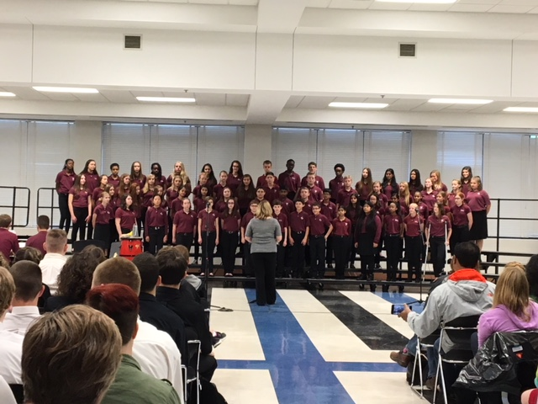
What to Expect
We start early
Depending on competition location, the drive is 1 ½ - 2 hours. There may also be 2 competition sites in which case we arrive at the first site where band or choir would perform, then load up and head to the 2nd location for the final performances
After performances, we head to the buses for sign out (next slide), students receive a snack and change on the buses
PARK TIME!! Typically is several hours until the awards ceremony which typically occurs early evening
Students then will have some more park time before we
head to the buses
Arrive back to Caravel between 9-10pm
*times will be provided once itinerary is confirmed with MIP

Slide 9
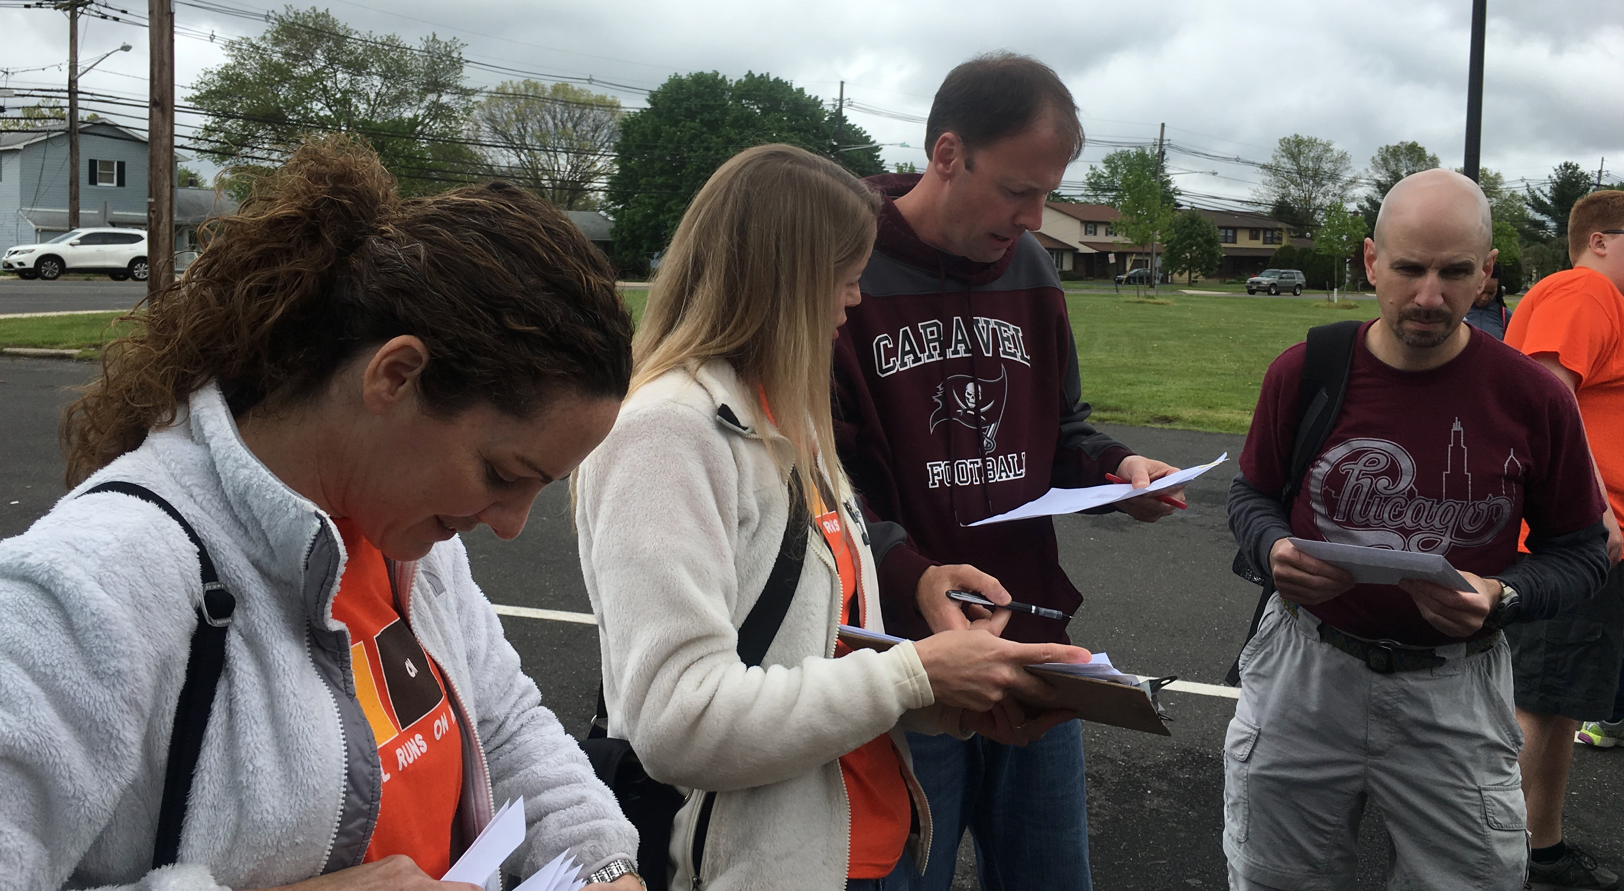
Sign Out Procedure
Students whose parents are driving to the competition separately may take custody of their child after all performances and group pictures have been taken. Students must be signed out prior to boarding the bus to head to the park. There will not be sign outs in the park.
Forms MUST BE SIGNED by parent/guardian stated would be released to as that relinquishes the CA Music Department’s custody of the student.
We will have groups of chaperones in close proximity of buses to assist with sign outs and distribution of tickets for students NOT continuing the trip on the buses.
Sign out your student (sign release form)
Receive your student’s park ticket
Parents/family members driving up are responsible for purchasing their own tickets
Get student’s instrument/travel bag off the bus
Students not being signed out
The bus captains will receive the tickets for the students on their bus and will distribute the student’s tickets after we have boarded buses in route to park

Slide 10
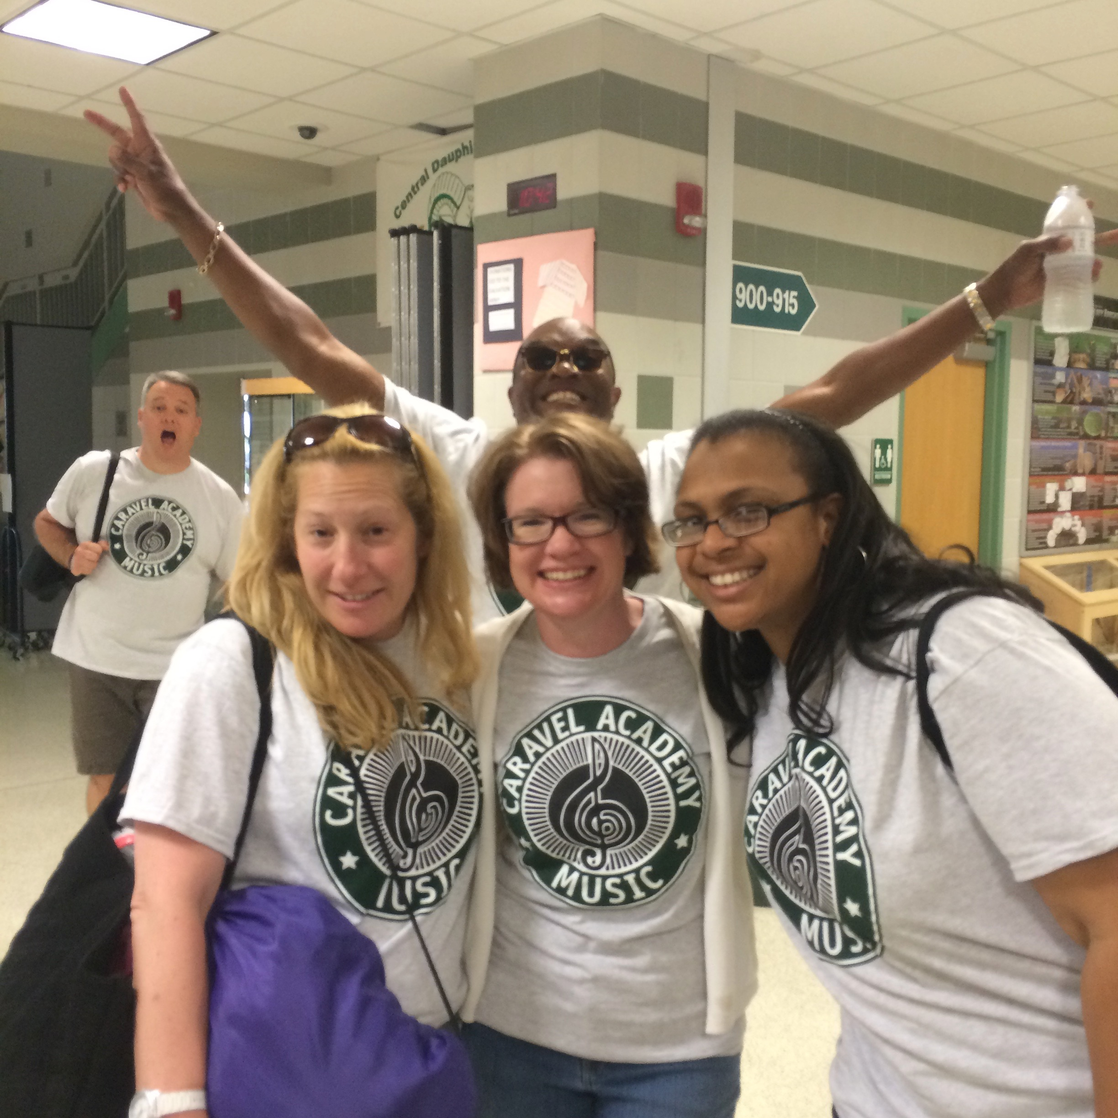
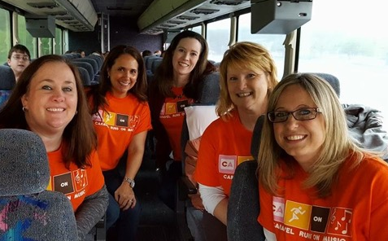
Chaperones
We rely heavily on parents as chaperones to help make these trips successful!
Bus Captains – we will have a captain for each bus who is responsible for:
Ensuring all students are present on the bus; taking attendance at every loading / unloading
Handing out tickets to the chaperones on the bus for the students in their group; given after performances once we embark for the park
Bring DVD movies to play on bus (great for ride home)
All Chaperones:
During the performances, all students will remain together as a group. Chaperones are asked to help ensure all students remain together…reminder we are being judged the entire time so their performance staff will be watching how our students act and behave even when not performing
While each band student is responsible for unloading their instrument at the performance location, chaperones will be needed to assist with unloading / loading equipment
Assist during sign out process. This gets very hectic with parents who are looking to sign their child out, students getting their snack, managing changing process so we ask all parents to assist where needed
We will load the boys on the buses and have them change. Once all are finished we will have the girls change
Once we arrive at the park, chaperones are responsible for the students in their group

Slide 11
Costs
Fees are determined based on:
Coach buses and driver tips
Music in the Parks festival entry fee (students only)
Park admission
Lunch in park (Hershey Park has buffet picnic; Six Flags provides food voucher)
MIP t-shirt
Students $125
Chaperones $105
*MIP fees as well as bus costs increased in 2019. Music Boosters will be covering partial costs to help offset passing the full increase on to parents.

Slide 12
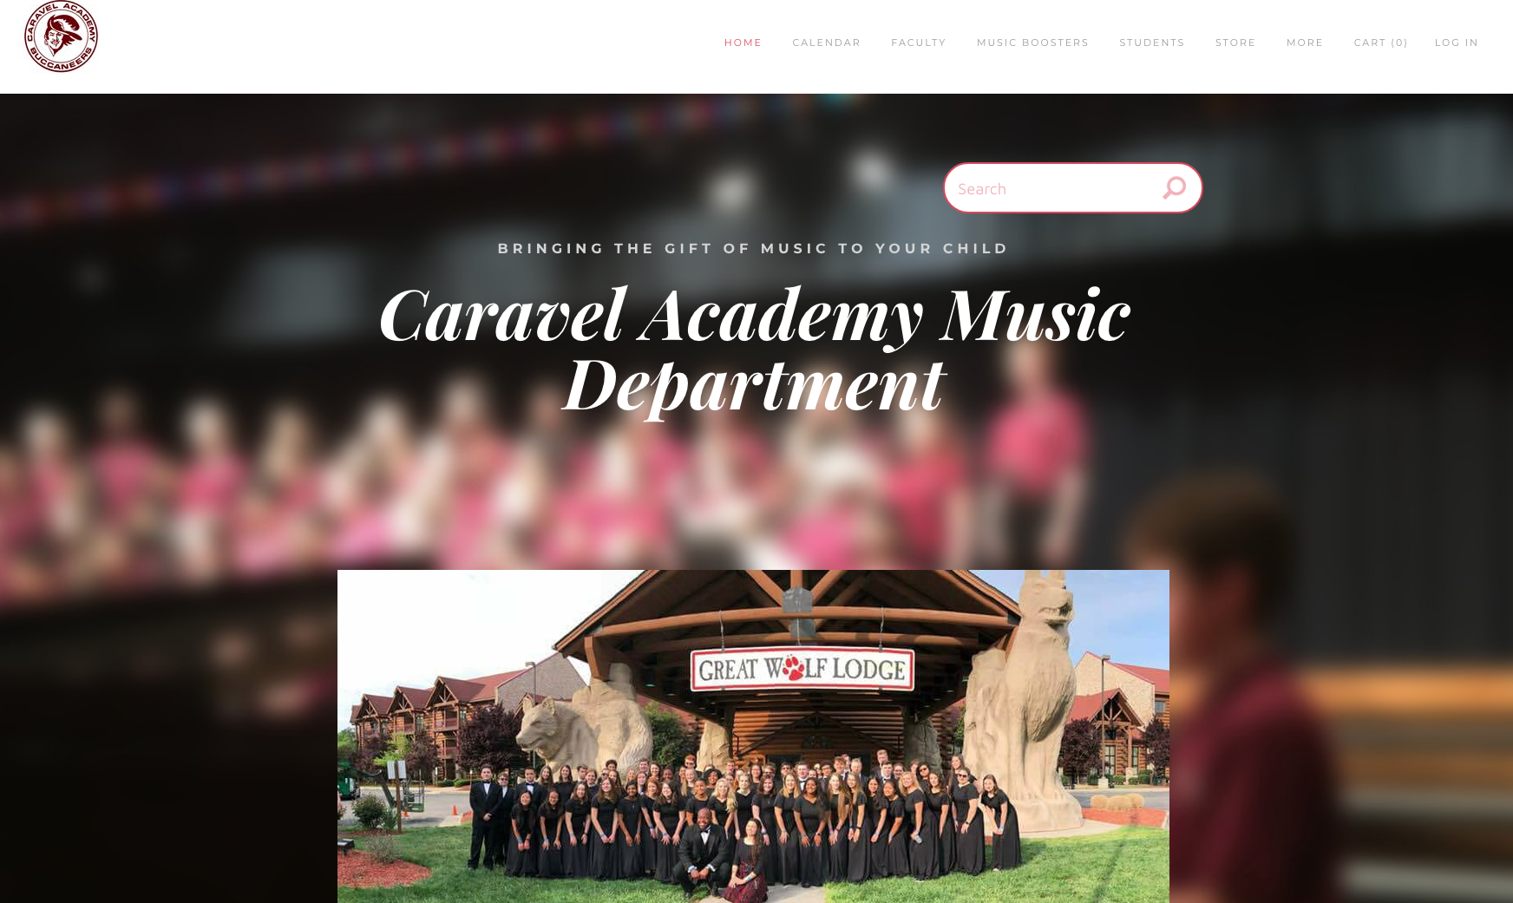
Registration - will open January 22nd
Registration is easy
Go to camusicboosters.com
At the top under Student click on Trip Registration for the appropriate trip. This page will require a password to open in order to keep everything secure. The password will be provided via email to parents prior to registration opening.
Click on the link to register.
Payment can be made via PayPal or by sending in a check.
There will also be a chaperone link within the registration that can be completed and then further information will be sent including payments for chaperones.

Slide 13
Questions?
Trip packets will be posted to the trip page on the CAMusicBoosters.com website – as soon as the details on times are available (likely late-February)

